Slide 1

Airbnb Listings in NYC
Lisbeth Ruiz
Alicia Ramos Perez

Slide 2
The Data
Is there a correlation between the location of these listings and their popularity or likeliness to be booked?
Manhattan/Brooklyn boroughs
The data wrangling process

Slide 3
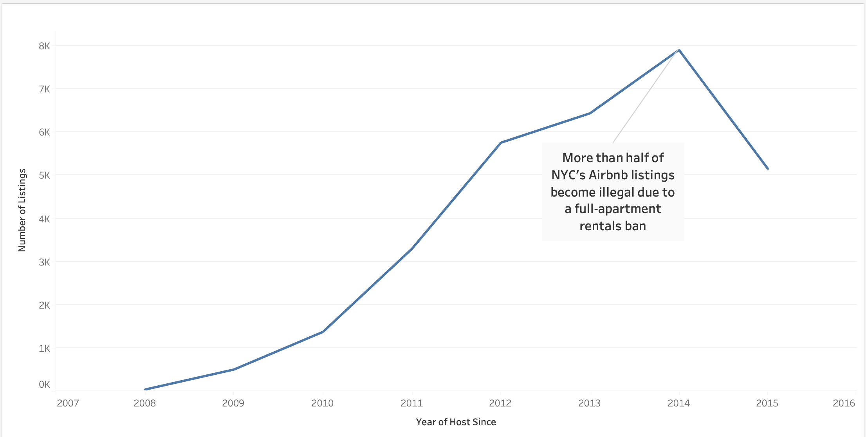
NYS Multiple Dwelling Law

Slide 4
Findings
The Manhattan Borough is where most of the listings are located.
It also has the highest average cost between all the boroughs as well as per room type.
While it scores highly in all categories, all boroughs share similar average review ratings. Indicating that the ratings don’t matter, but the location does!

Slide 5
Conclusion
Tourist POV
While Manhattan may be more expensive, looking at transportation factors and overall convenience, it may not be such a bad idea.
Everyone wants a piece of that New York state of mind!

Slide 6
References
https://ny.curbed.com/2016/6/28/12050662/airbnb-illegal-nyc-study
https://www.theverge.com/2015/1/21/7865959/airbnb-under-fire-new-york-city-city-council
https://www.worldtaximeter.com/new-york
https://www.townandcountrymag.com/leisure/arts-and-culture/g40547076/best-shows-filmed-in-nyc/
https://docs.google.com/spreadsheets/d/1iWCNJcSutYqpULSQHlNyGInUvHg2BoUGoNRIGa6Szc4/edit?usp=sharing
airbnb copy 3.xlsx

